Slide 1
Heart Beat Measuring Device
Qamber abbas 6217000198
Sayed asad Hussain 6217000162

Slide 2
heart beat measuring device
Aim In this project we presented the design and development of device for measuring heart rate using fingertip to improve estimating the heart rate. As heart related diseases are increasing day by day, the need for an accurate heart rate measuring device or heart monitor is essential to ensure quality of health.

Slide 3
heart beat measuring device
Tools
Arduino nano
Heartbeat Sensor
Connecting Wires
Programming Languages
Arduino IDE
Visual Studio

Slide 4
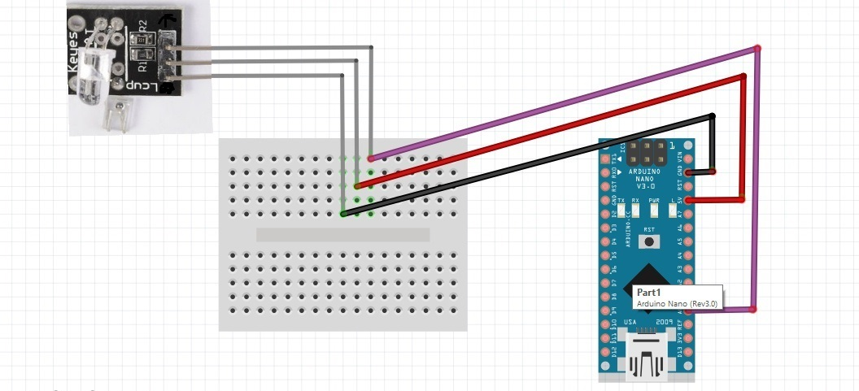
heart beat measuring device
Circuit Diagram

Slide 5
heart beat measuring device
Objectives
Programming Arduino Hardware
Design and Development of GUI
Functionality
Design and Construct a Pc based heart monitoring System
The heart sensor will sense a finger and then send the signal to the inbuilt analogue to digital converter of the Arduino

Slide 6
heart beat measuring device
Why this device important ??
device is important is to prevent harmful events from occurring to the human.
Heartbeat Measuring System is a system that can be used in hospitals

Slide 7
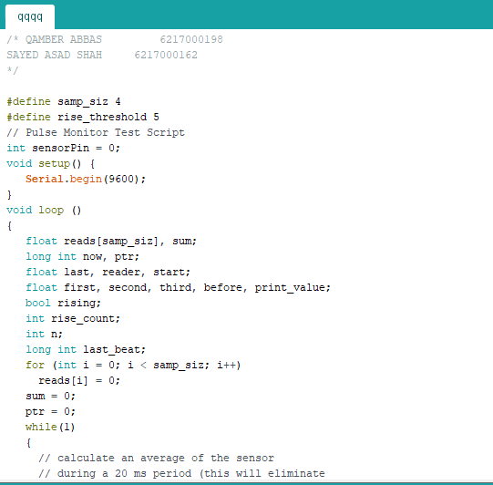
heart beat measuring device
Arduino Code

Slide 8
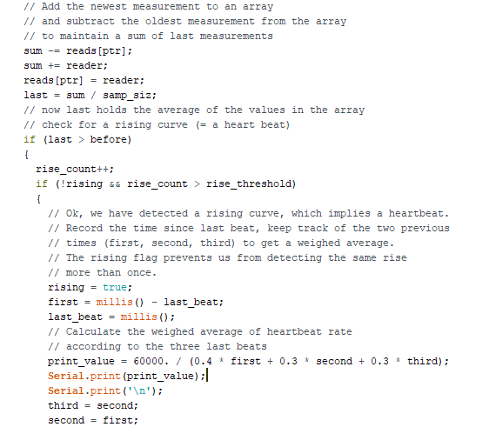
heart beat measuring device
Code

Slide 9
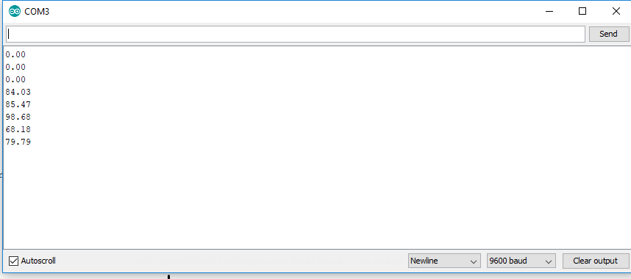
heart beat measuring device
Arduino output

Slide 10
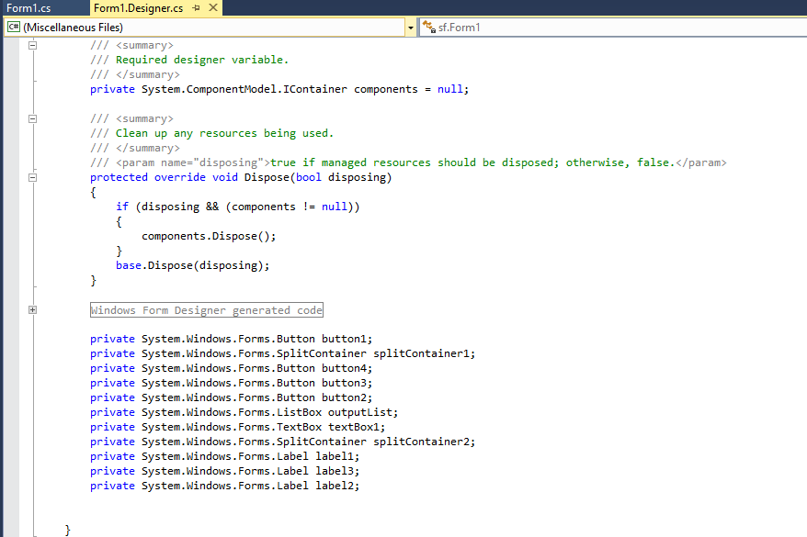
heart beat measuring device
GUI Code

Slide 11
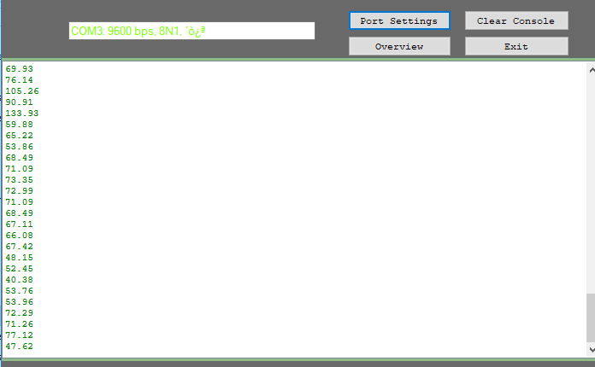
heart beat measuring device
GUI (Graphical User Interface)

Slide 12
Thank you for listening

